Slide 1
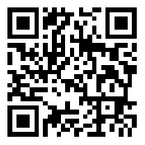
International
Celebrating 100 Years
Let’s meditate
for 21 days
25th February to 17th March 2023
Presented by Sahaja Yoga Meditation English • French • Mandarin • Hindi • Italian • German • Arabic
The Birth of H.H. Shri Mataji Nirmala Devi
freemeditation.com.au/feb2023
Always free

