Slide 1
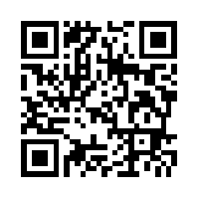
International
Let’s meditate
Celebrating 100 Years
for 21 days
25th February to 17th March 2023
Presented by Sahaja Yoga Meditation English • French • Mandarin • Hindi • Italian • German • Arabic
The Birth of H.H. Shri Mataji Nirmala Devi
Always free
freemeditation.com.au/feb2023

